Slide 1

Photodissociation in the Solar Nebula:
Models and Meteorites
James R. Lyons
School of Earth & Space Exploration
Arizona State University
Photodissociation Workshop
Kasteel oud Poelgeest, Leiden
3-5 February2015
Notes:
1

Slide 2
Isotopic Photodissociation Topics
Spin-forbidden CO₂ photolysis – Mars atmosphere
SO₂ photolysis (~200 nm) – early Earth atmosphere
Oxygen isotopes in Sun and meteorites
CO photodissociation in solar nebula & protoplanetary disks

Slide 3

Geochemical delta notation

Slide 4
Mass-independent fractionation on a 3-isotope plot
δ¹⁷O_{SMOW}
O-MIF
Δ¹⁷O
slope 0.52 (TF)
δ¹⁸O_{SMOW}
Notes:
4
4
4

Slide 5
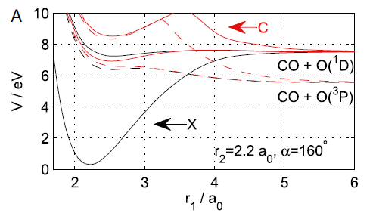
Nair et al. (1994)
167 nm
227 nm
Schmidt et al. 2013

Slide 6
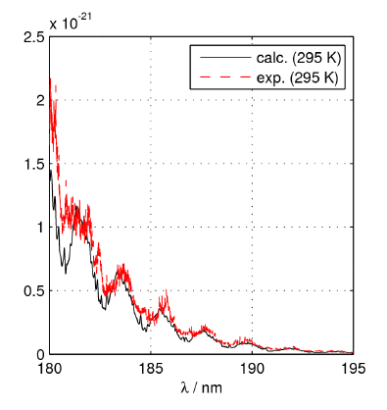
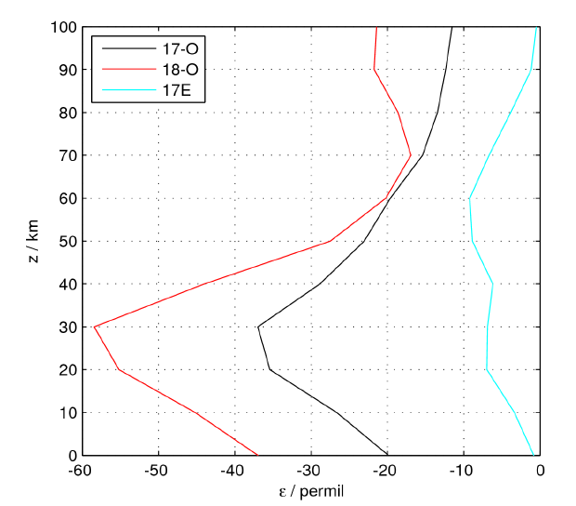
Mars atmosphere
185 nm
Schmidt et al. 2013

Slide 7
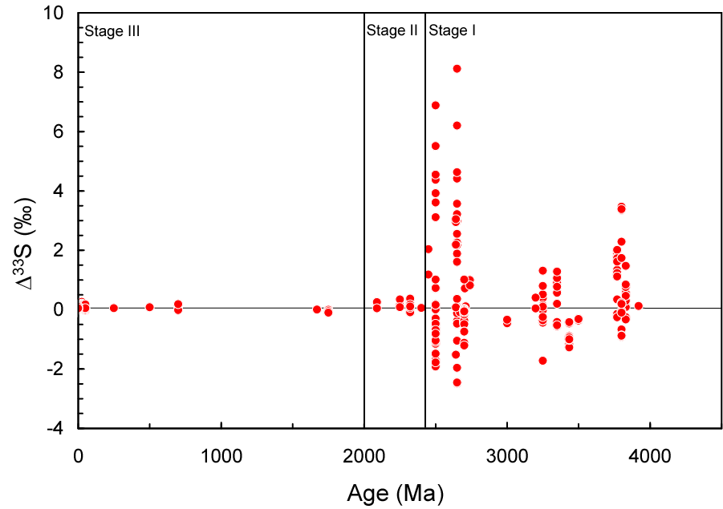
Record of S-MIF in sedimentary rocks
pyrites
barites
Farquhar et al. 2000
Notes:
7

Slide 8
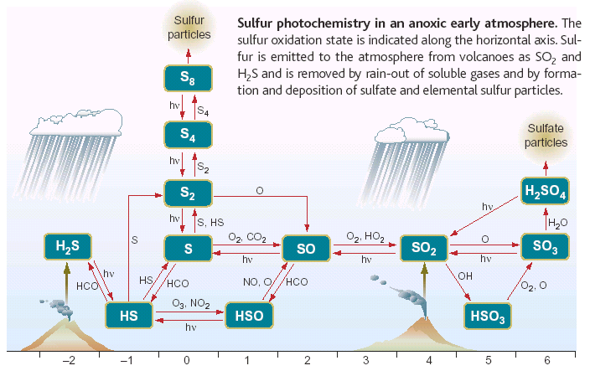
Low-O₂ atmospheric sulfur chemistry
pO₂ < 10⁻⁶ atm
Pavlov &
Kasting 2002
Kasting 2001 (from Kasting et al. 1989)
Notes:
8

Slide 9
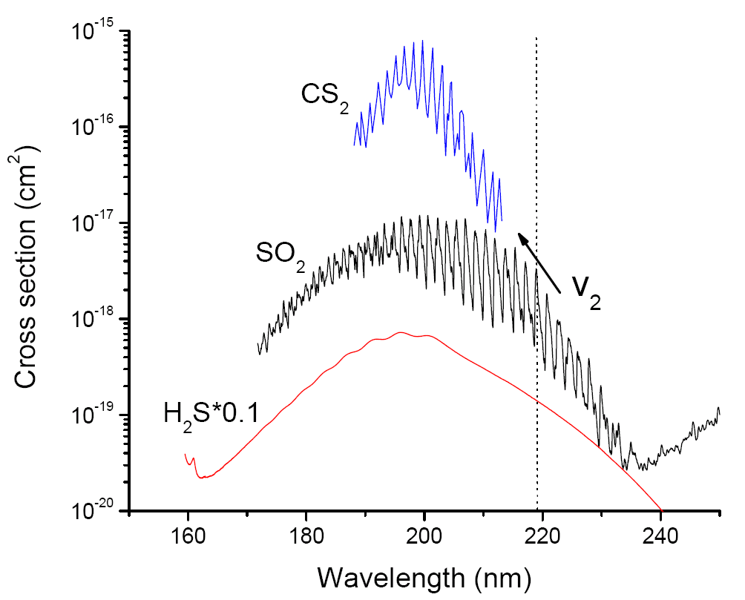
SO₂, H₂S and CS₂ absorption cross sections
v₂
Notes:
9

Slide 10
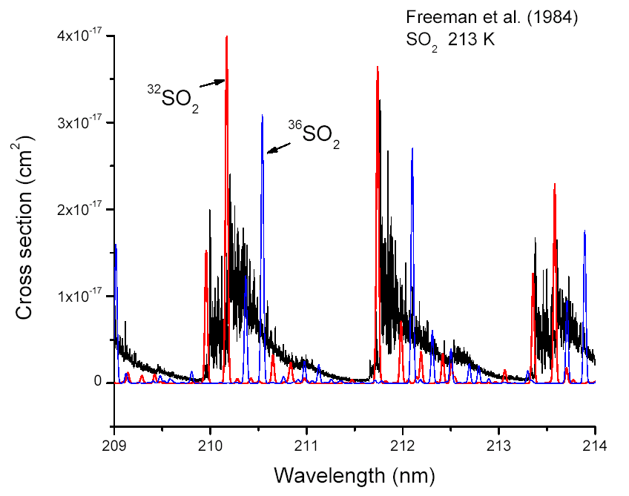
ab initio:
Ran et al. 2007
v₂=9
8
7
Lyons 2008
Notes:
10

Slide 11
Wavelength shift of SO₂ isotopologues
32
36
Lyons 2008

Slide 12
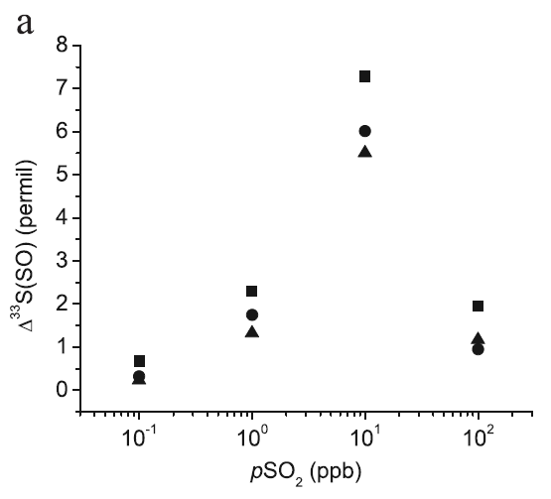
Calc
rock values
Lyons (2007)

Slide 13
SO₂ + hv
experiments
Ono,
Whitehill,
Lyons
2013

Slide 14
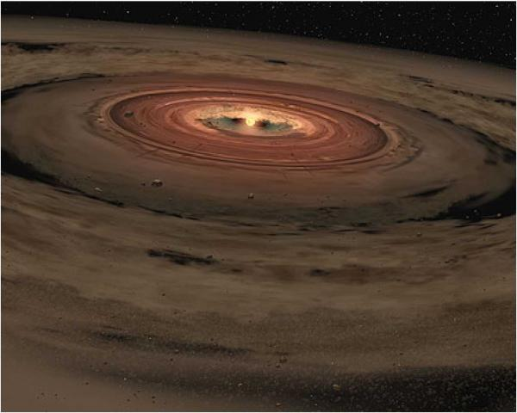
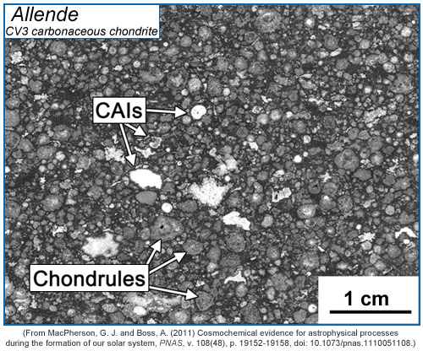
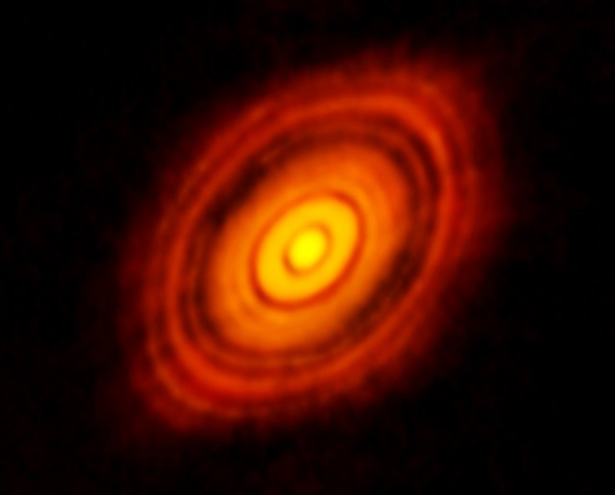
Notes:
14

Slide 15
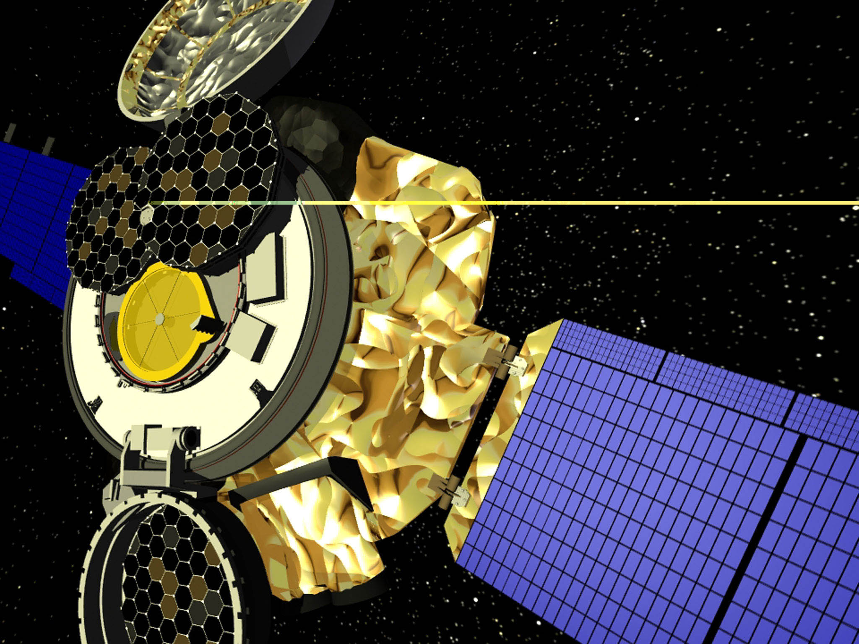
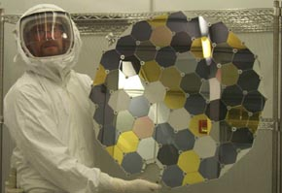
Notes:
15

Slide 16
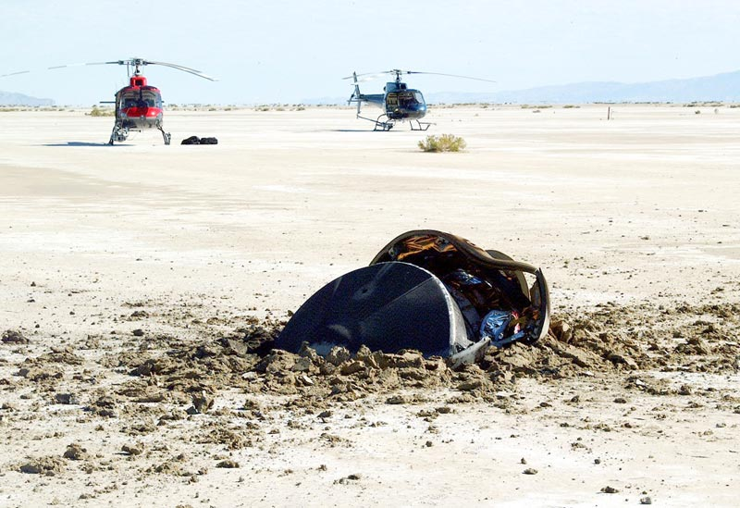
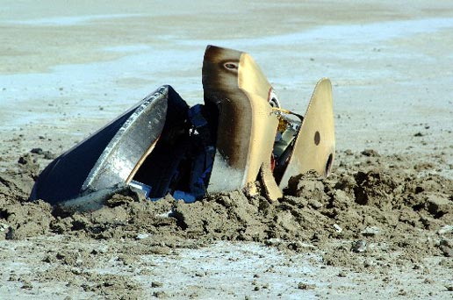
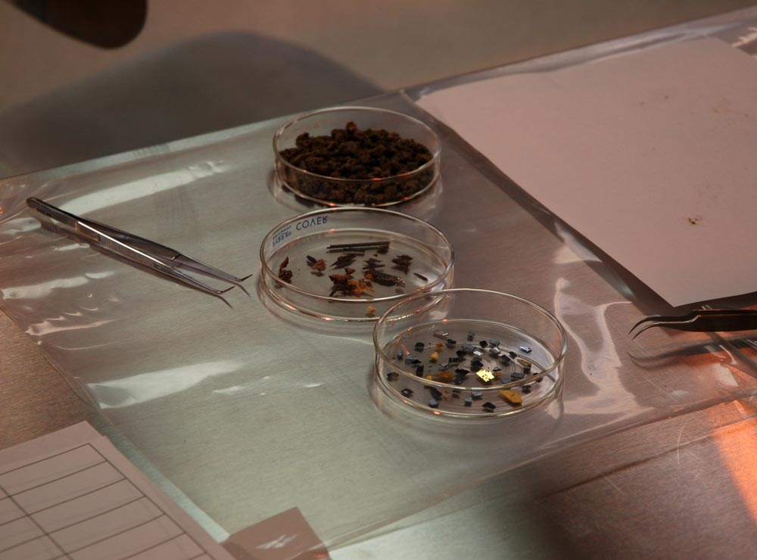
Notes:
16

Slide 17
Oxygen isotopes in the solar system
photosphere
(2004)
G94
(inferred)
HR96
McKeegan et al. 2011
Ayres et al. 2013

Slide 18
Oxygen isotopes in the solar system
(inferred)
HR96
McKeegan et al. 2011
Gharib-Nezhad et al. 2015

Slide 19
Self-shielding in a 2-D disk
H₂O
snowline
Notes:
19

Slide 20
Self-shielding of CO in outer disk surface
G₀=500
Lyons & Young 2005
Notes:
20

Slide 21
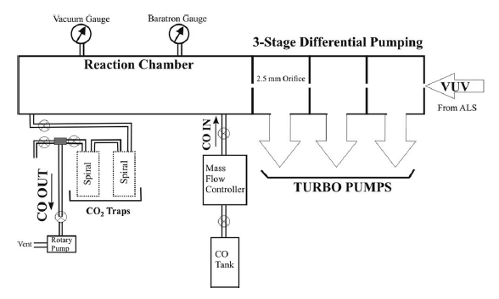
Chakraborty et al. 2008, 2012

Slide 22
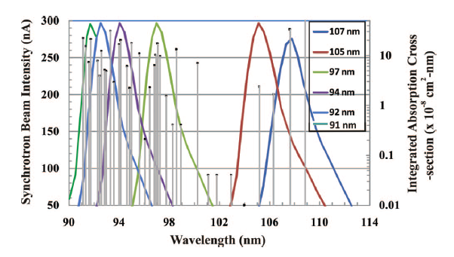
Chakraborty et al. 2008, 2012

Slide 23
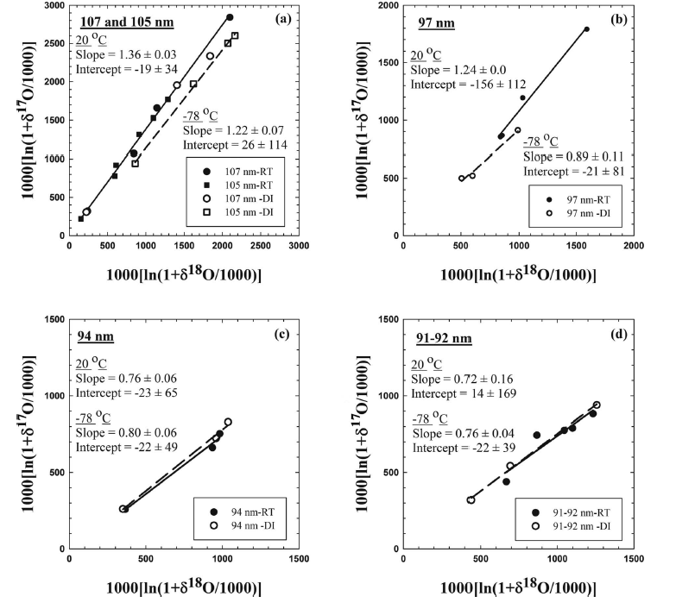

Slide 24
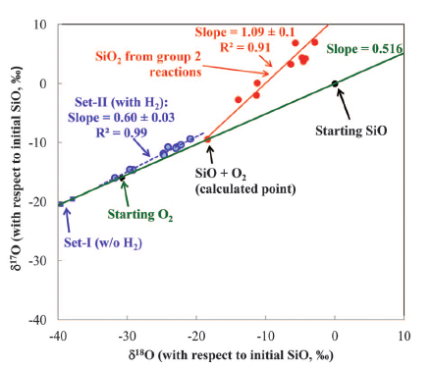
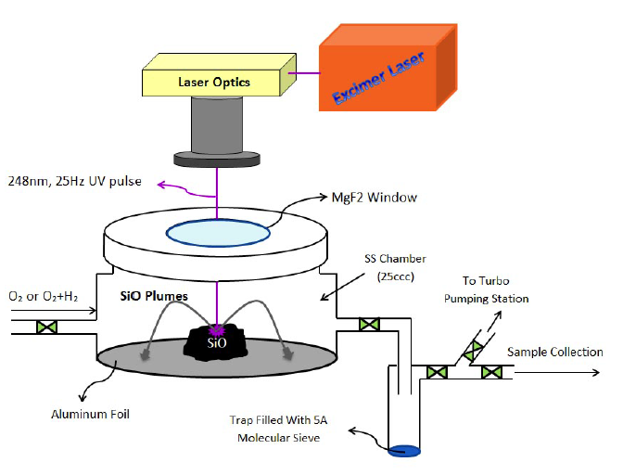
SiO + OH → SiO₂ + H
Chakraborty et al. 2013

Slide 25
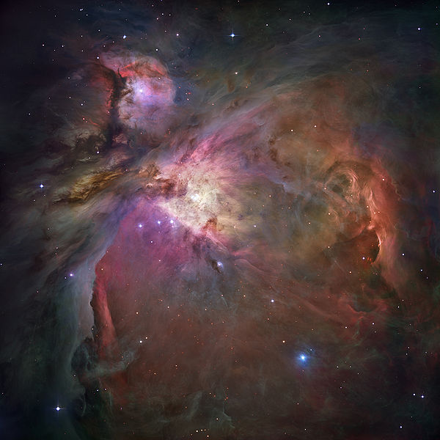
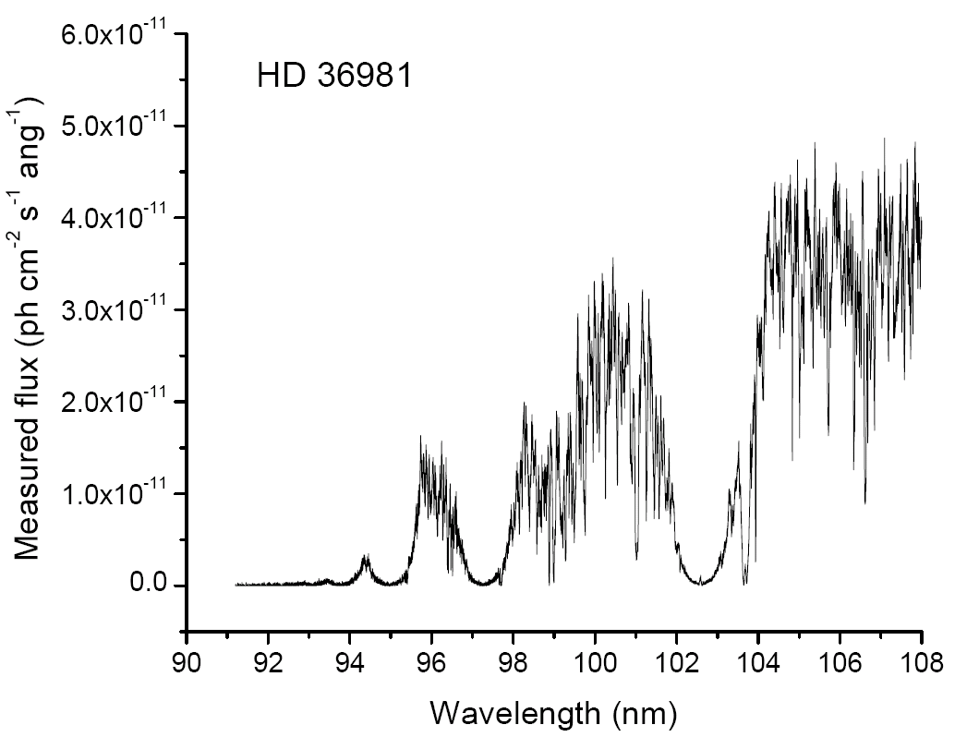
HD 36981

Slide 26
Influence of CO E¹Π(0) – X(0) dissociation probabilities
Lyons (2014)

Slide 27
¹²C¹⁶O transmission spectra measured at Soleil

Slide 28
Isotopic CO E¹Π(1) – X(0) absorption cross sections
Stark et al. 2014

Slide 30
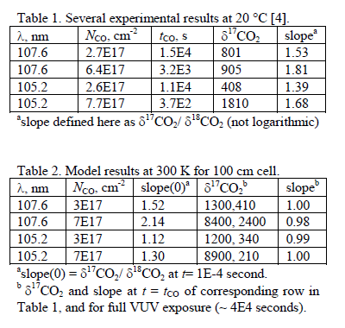

Slide 31
Summary
Spin-forbidden CO₂ photolysis: No hyperfine assist. High
quality ab initio cross sections from Schmidt et al. (2013).
SO₂ photolysis: Isotopic shifting of vibronic peaks, with ³²SO₂
rotational features copied, works. SO₂ is not the MIF source.
Solar photosphere oxygen isotopes consistent with Genesis inferred
photosphere isotope ratios. Latest CO vib f-values close to HR96.
High-resolution CO E-X & C-X isotopic cross sections exhibit
C¹⁶O and C¹⁸O self-shielding initially, but not at later times.
Need 1217 and 1218 dissociation probabilities for CO E(0)-X.

Slide 32
Acknowledgements
Colaborators:
Glenn Stark, Alan Heays, Michelle Eidelsberg, Jean-Louis Lemaire
Steve Federman, Douglas Blackie, Juliet Pickering, Andreas Pack,
Tom Ayres
Student (ASU): Ehsan Gharib-Nezhad
Soleil DESIRS beamline: Nelson de Oliveira, Laurent Nahon
Funding:
NASA Origins of Solar Systems
NASA Astrobiology/Exobiology

Slide 34
